Slide 1

MOVIE Recommendation Engine Building
Presenter: Weizi Yuan

Slide 2
Introduction
In this project, the movie data is movie lens data set which includes about 600 users and 9500 movies.
The purpose of the project are to:
find similar movies.
gain insights on movie recommendations to users
To achieve the goal, we will:
(1) Train the regression model with Alternating Least Squares (ALS) algorithm.
(2) Predict movie rating and recommend movies to users.
(3) Find the correlations between different movies and infer similarities.
This will be implemented on Spark due to its fast speed for large-scale data processing and readiness to use.

Slide 3
Take a glance at the data
Reference: Sparsity = $\left(1−\frac{rating_{numbers}}{movie_{numbers}×user_{numbers}}\right)×100\%$
Movies
Ratings
Conclusion
Movie Info
Total # of movies | 9742
# of movies rated | 9724
Avg # of ratings per movie | 10
# of movies received only 1 rating | 3446
Rating Info
Total # of users | 610
Avg # of ratings per user | 165
Min # of ratings among users | 20
Sparsity | 98.30%
The rating dataframe is 98.3% empty, this on one hand emphasizes the need of predicting the rating to enrich it. On the other hand, it brings difficulty to the prediction due to sparse data.

Slide 4
Train the model
Since large iteration requires significant time, we first fix MaxIter = 10, only tune rank and RegParam.
Then, we increase the iteration to 50.
 | Hyperparameters |  |  | Error | Comment
 | Rank | MaxIter | RegParam | RMSE
Param_grid | 3,5,10 | 10 | 0.05,0.15,0.25 | 0.874(test)/ 0.698(all) | Runs ~ 20 min
Best model_50 | 10 | 50 | 0.15 | 0.871(test)/ 0.687(all) | Runs ~4 min
We chose a rank of 10, iterate 50 times and regPram = 0.15,a RMSE of 0.69 on all data was achieved. This means that on average the model predicts 0.69 above or below values of the original ratings matrix.
However, it seems that increasing iterations from 10 to 50 helps little. We might need better improvement method. This will be discussed later.

Slide 5
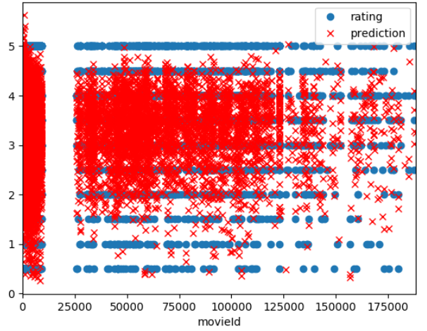
Model performance
Compare the prediction and rating:
This looks messy. Because the rating was on a scale of 1-5, with an interval of 0.5. However, the predicated one was a continuous number.
rating
How about let’s we convert the predication to the rating scale to get a sense how good/bad our model performance is?

Slide 6
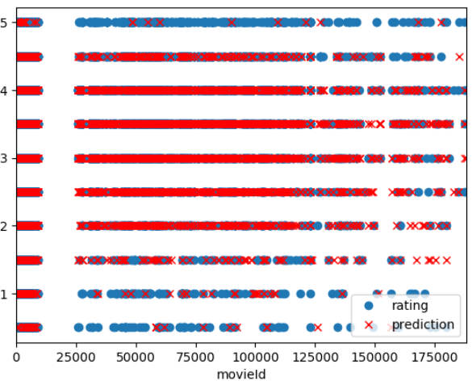
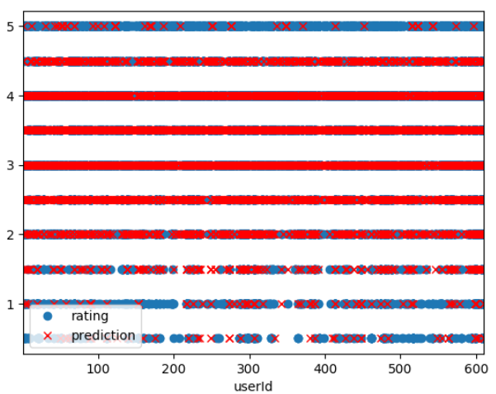
Model performance on test data
Predicting movie rating
Predicting user rating
rating
rating
Now, it looks much better.
From the above plot, we can see that overall model did a good job on predicting the user rating. Specifically, the result looks great between 1.5-4.5, however, when predicting extreme scores(either low or high) like 0.5 or 5, it needs improvement.

Slide 7
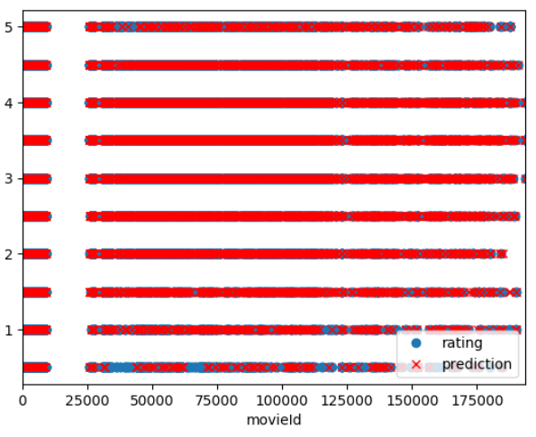
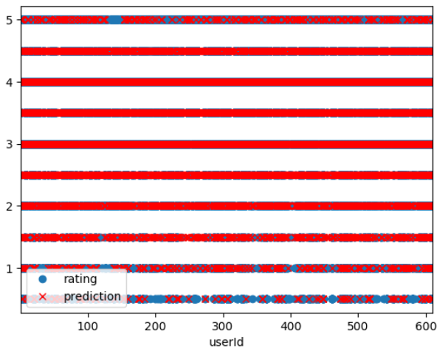
Model performance on all data
Predicting movie rating
Predicting user rating
rating
rating

Slide 8
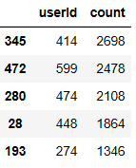
Recommendation
We will recommend users with movies they have not watched before. (rating is Null before)
We prefer to recommend users with high rating counts. The more movies the users rated, the more reliable the recommendation will be.
In this case, we choose users 414, 599.

Slide 9
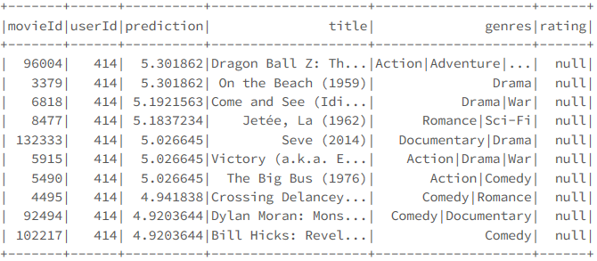
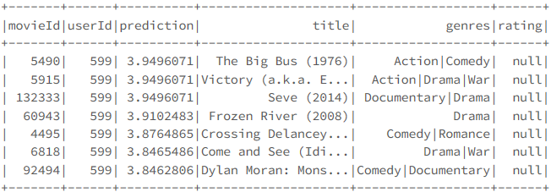
Movie recommendations
User 414
User 599

Slide 10
Finding similar movies
Idea:
We find similar movie based on the correlation between movie ratings, the closer the correlation between movie A and B to 1, the more similar they are.
Challenge:
Some movies have very few ratings and may end with high correlation simply because only one or two users gave them similar ratings. These are not reliable results.
Solution:
To fix this ,we need to set a threshold for the number of ratings.

Slide 11
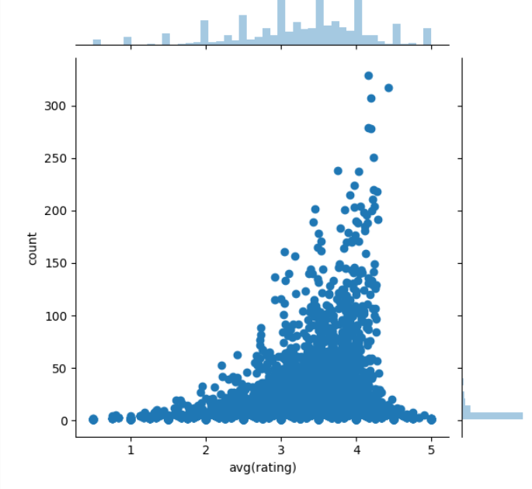
Finding similar movies
From the histogram, we saw a sharp decline in number of ratings from 100.
Therefore, we will choose this as our threshold. This is saying, we will only find similar movies that have been rated more than 100 times.

Slide 12
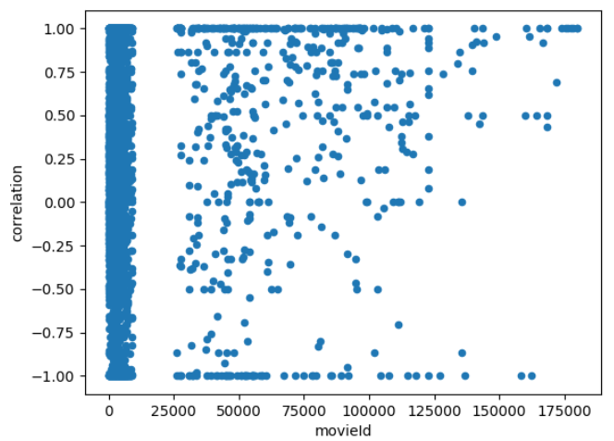
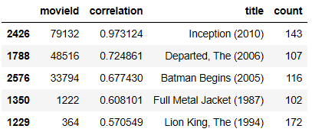
Similar movies to 471
correlation

Slide 13
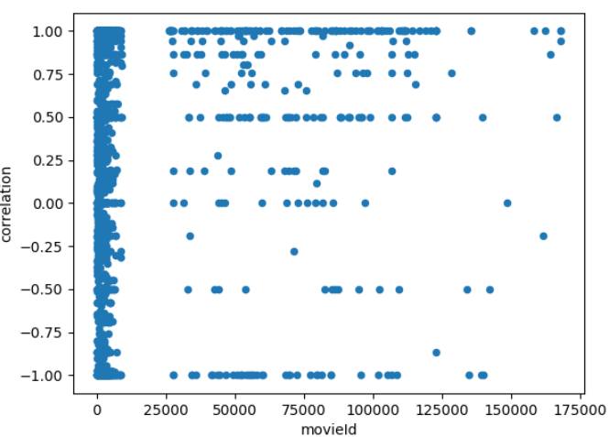
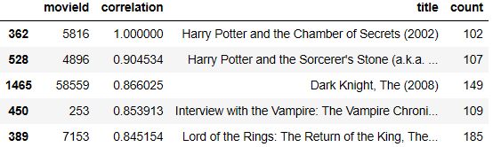
Similar movies to 464
correlation

Slide 14
Summary
Overall, the model did a good job on predicting the user rating, specifically, between 1.5-4.5. However, when predicting extreme scores(either low or high) like 0.5 or 5, it needs improvement.
Two possible reasons:
most ratings are between 2-4(we can tell from the avg(rating)-count plot), which means extreme high or low ratings are sparse, therefore, to accurately predict ratings in this region may be more difficult.
We know that the dataframe is highly sparse(98.5%), again bring challenges to the prediction.
Suggestions :
(1) We could further increase iteration to lower the RMSE, however, due to long running time, we didn’t try it here. Also, we noticed before, this didn’t really help too much.
(2) Collect more data.
For now, it is not a good idea to use a more complex model due to limited ratings.
In the future, we could encourage users to rate the film for low sparsity. With larger dataset, we could use a more complex model, for example, neural network for better performance.

Slide 15
Reference
1. MovieLens Datasets
Data can be found here:
https://grouplens.org/datasets/movielens/latest/
2. https://databricks-prod-cloudfront.cloud.databricks.com/public/4027ec902e239c93eaaa8714f173bcfc/2268229575846883/1611422526940121/6723471235902913/latest.html

Slide 16
Thank YOU FOR YOUR TIME!

